Slide 1
Checking Network/Port Connectivity using Kaseya Agent Procedures
Developed By: Emmanuel Giboyeaux
Advisor : Dr. S. Masoud Sadjadi
School of Computing and Information Sciences
Florida International University
egibo001@fiu.edu
http://www.cs.fiu.edu/~sadjadi/

Slide 2
Agenda
Problem and Motivation
Solution
Behind the Scene
Customizing the Solution
Disclaimer
Progress Report

Slide 3
Problem and Motivation:
A client would like to check the health of their network connection.
The client would also like to set up printer sharing at their workplace.
Knowing what ports are opened and closed would allow the client feel more secure.

Slide 4
Solution
Use an agent procedure that pings an address to check if it is working properly.
Use an agent procedures to check what ports are open or closed.
If the ports are not working correctly, an email will be sent to the administrator.

Slide 5
Behind the Scene
Part one of the ping check creates a folder to store the information.
The agent procedure pings and address and creates a text file that store the results
Creates a variable that contains the content of the file with the results and then executes part two of the ping check procedure

Slide 6
Behind the Scene cont.
In part two of the procedure if the variable created does not contain Lost = 0 then it creates an email stating that the ping test didn’t pass, deletes the text file and writes a statement in the procedure log.
If the ping test passes then it simply writes a statement saying so in the procedure log.

Slide 7
Behind the Scene cont.
To monitor ports another agent procedure would create several variables; one for the host/ IP address, port number, list of emails to contact, and one for an agent directory
Deletes a pingout.txt if it already exits
Executes a command that checks the port and creates a new pingout.txt file with the results
Creates another variable to store the contents of the new text file and then deletes the text file
Executes part two of the port check procedure

Slide 8
Behind the Scene cont.
If the last variable created does not contain Connection Successful then it sends out an email to the contacts listed stating which host/ IP address and port failed to respond.

Slide 9
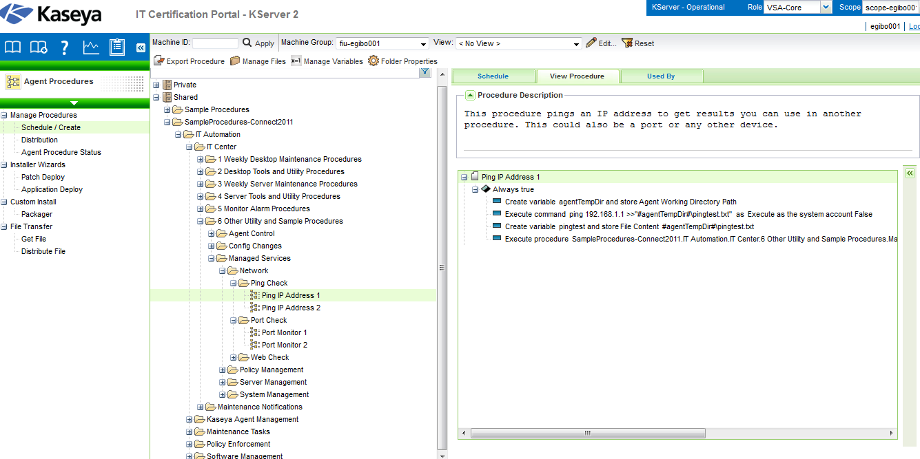
Figure 1.1

Slide 10
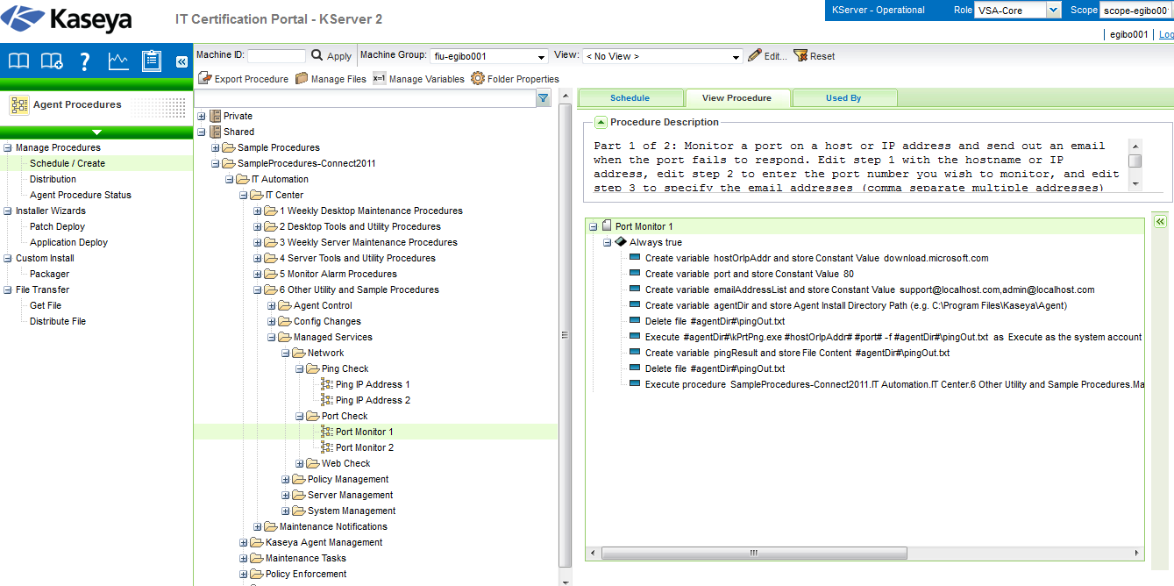
Figure 1.2

Slide 11
Customizing the Solution
Edit the values for the host/ IP address and the ports
Add a line of code that can automatically find ports
Modify the contents of the email

Slide 12
Disclaimer
Not knowing the port number
Should be able to work on all systems
If trying the customized solution for finding ports, procedure might have to be altered to work on different operating systems.

Slide 13
Progress Report
Trial and error with the video tutorial
Test the procedures
Need to complete documentation

